Slide 1

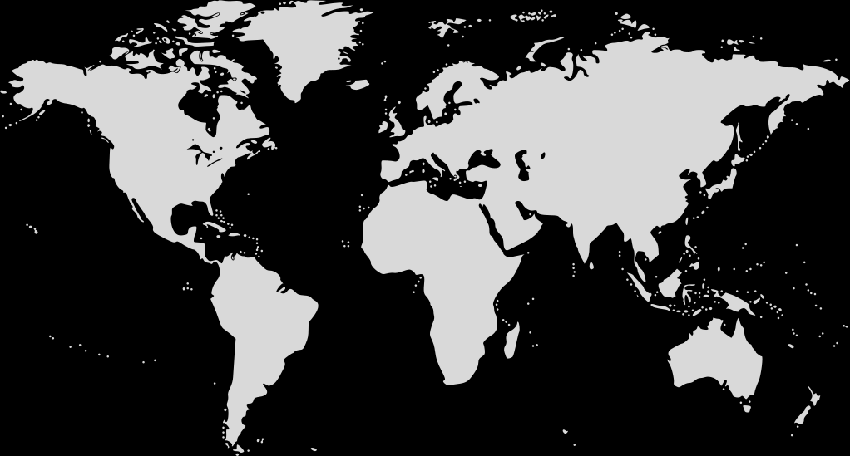

FOHOR MALAI
ADVANCING HEALTH IN NEPAL
THROUGH TECHNOLOGY
“Growing Business with Environment Care”

Slide 2
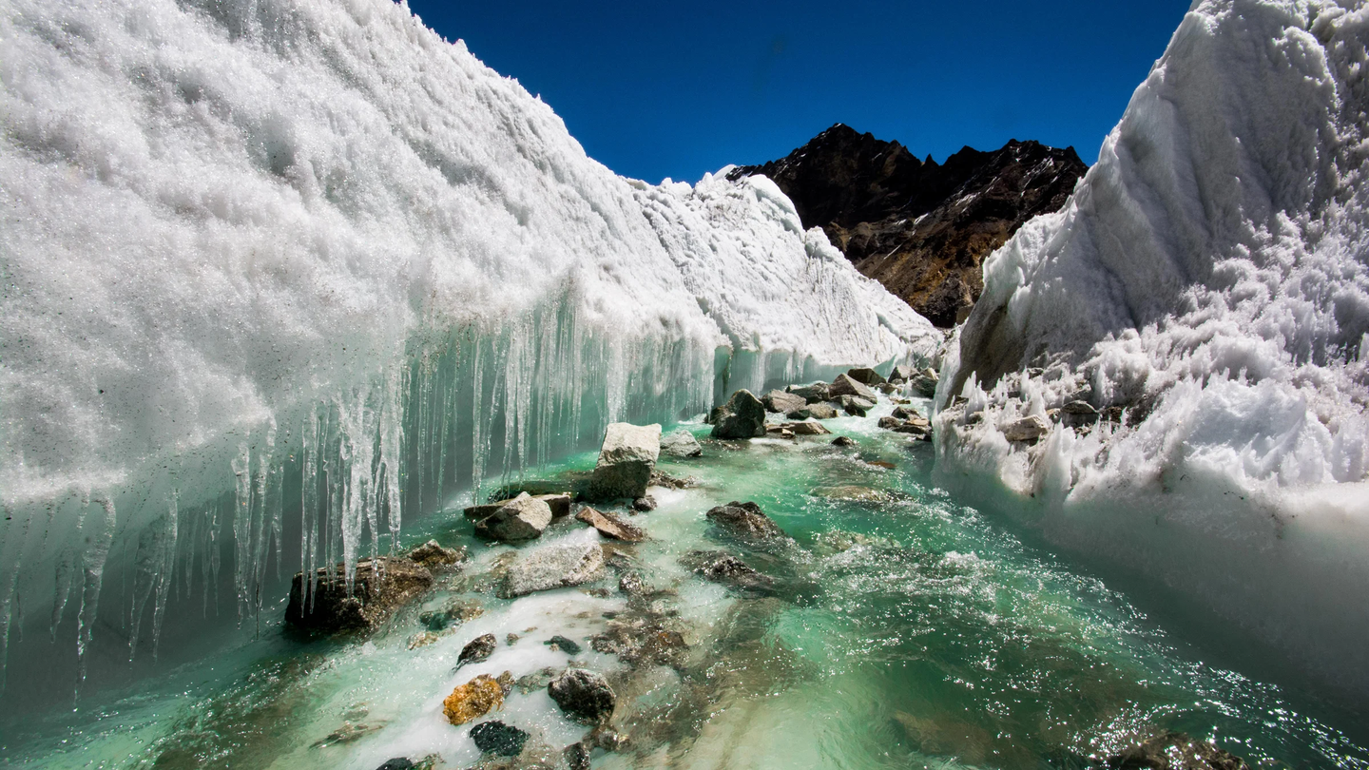
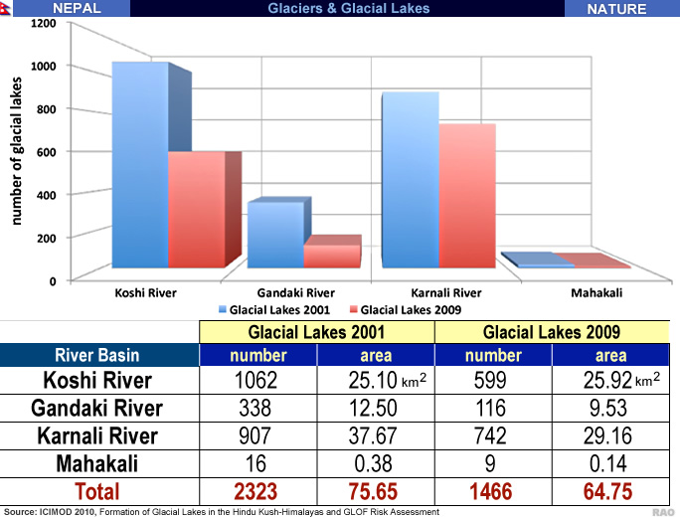
ENVIRONMENTAL IMPACT
Glacier Melting

Slide 3
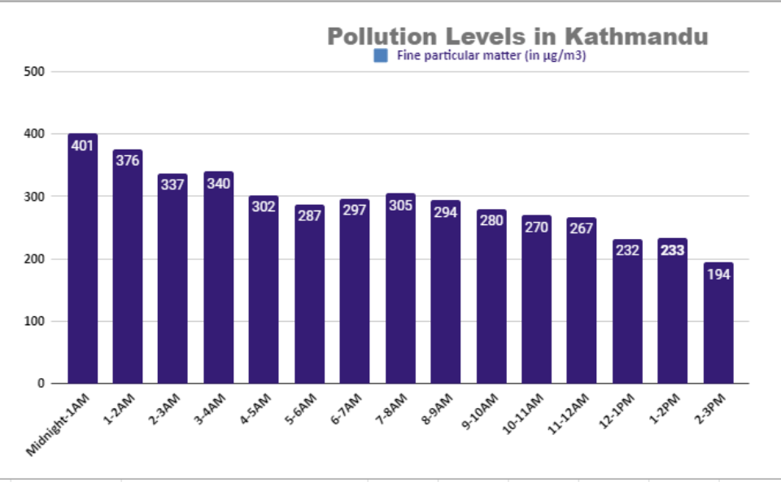
ENVIRONMENTAL IMPACT
Decrease in Air Quality Index

Slide 4

OUR
PROBLEMS
Health Risks.
Bad practice of Sanitation.
Environmental Impact.
Lack of awareness.

Slide 5

OUR MISSION
Promoting Sustainable Practice.
Reduce Evironmental impact.
Empower communities to practice.

Slide 6

OUR SOLUTION
MINIMIZING HEALTH RISK

Slide 7
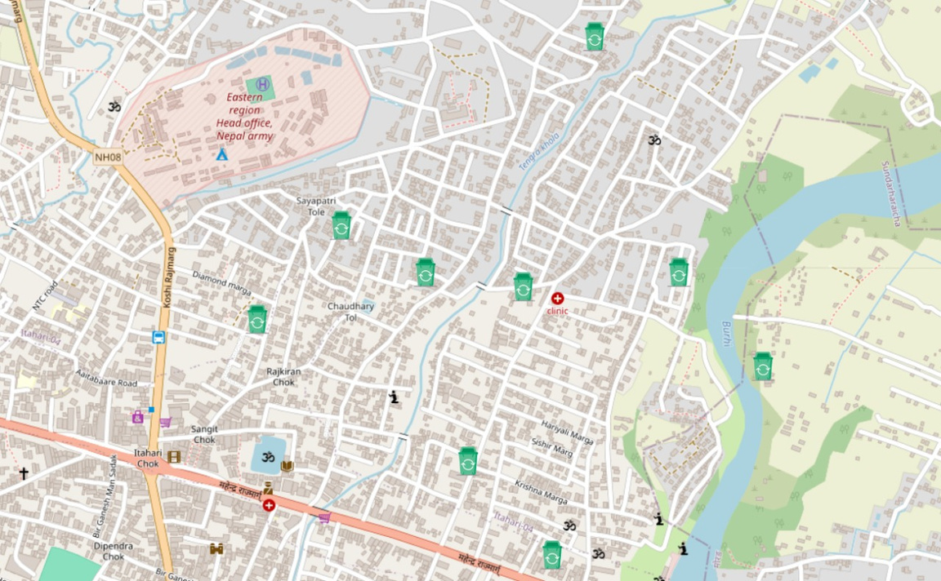
OUR SOLUTION
SPREADING HEALTH AWARENESS

Slide 8

FUTURE IMPLEMENTATION
Real-Time Tracking.
Share Success Cleaning.
Online Payment Integration.
Scalability.

Slide 9
Commission Based Revenue
Commission Structure
Value Proposition for Collectors
BUSINESS MODEL
Understanding our Revenue Generation Strategy
Sustainability of Commission Model

Slide 10
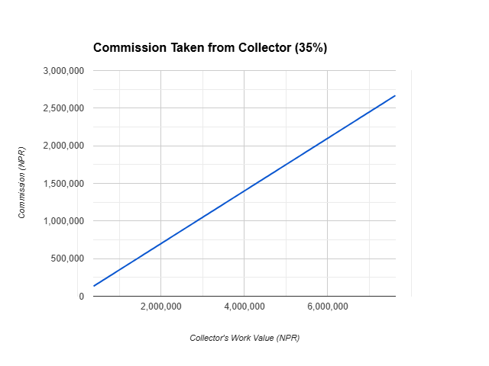
BUSINESS MODEL

Slide 11
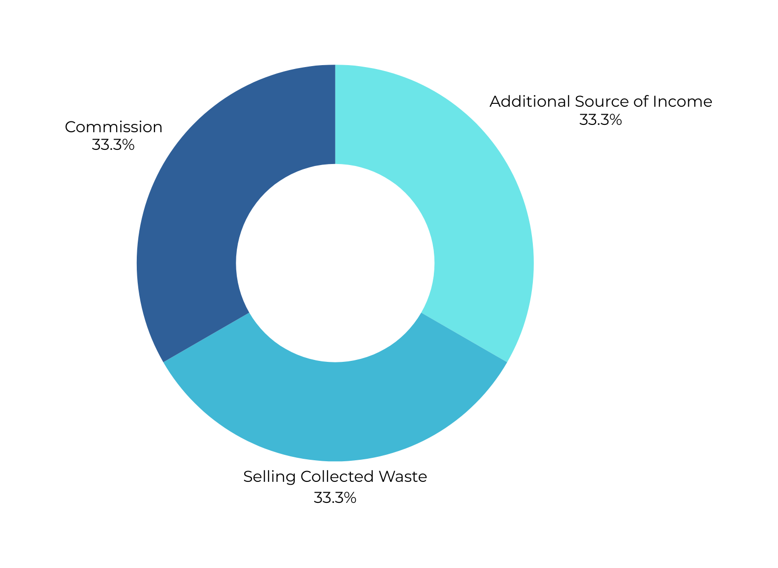

Slide 12
CONCLUSION
Environment maintenance plays vital role in advancing Nepal health and waste management can leads to the sustainable environment.

Slide 13

Presentation by Reactango Coders
THANK YOU

